Slide 1
Employee Data Analysis using Excel
STUDENT NAME: PUGAZH.K
REGISTER NO: 312220387
DEPARTMENT: B.COM GENERAL
COLLEGE: APOLLO ARTS AND SCIENCE COLLEGE

Slide 2
PROJECT TITLE
Employee Performance Analysis using Excel

Slide 3


AGENDA
Problem Statement
Project Overview
End Users
Our Solution and Proposition
Dataset Description
Modelling Approach
Results and Discussion
Conclusion
3/21/2024 Annual Review

Slide 4

PROBLEM STATEMENT
COMPUTATION OF NET SALARY THROUGH SALARY BY WORKING DAYS INTO NUMBER OF DAYS PRESENT

Slide 5

PROJECT OVERVIEW
.
THE OUTPUT OF THE PROJECT IS TO FIND NET SALRY

Slide 6

WHO ARE THE END USERS?
AT THE END USE WE FIND THE NET SALARY

Slide 7

OUR SOLUTION AND ITS VALUE PROPOSITION
EQUATION= (=E2/K2*L2)

Slide 8
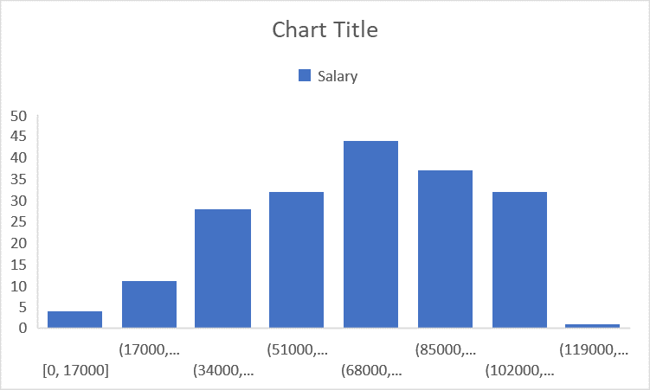
Dataset Description

Slide 9

THE "WOW" IN OUR SOLUTION
OUR SOLUTION IS FINDING THE NET SALARY OF THE EMPLOYEES
3/21/2024 Annual Review
9

Slide 10
MODELLING
THROUGH EXCEL IN BAR CHART
10

Slide 11
RESULTS
THE RESULT IS THE HIGHEST SALARY IS 68000
11

Slide 12
conclusion
WE FIND THE NET SALARY

